Slide 1
Stack:-
Stack is an ordered collection of items in to which new items may be inserted and from which items may be delete at one end, called tope of the stack.
Two operations are possible on stack:-
push:- Add item in to stack.
(2) Pop :- delete the item from stack.

Slide 2
operations in stack:-
push:- Add item in to stack.
(2) Pop :- delete the item from stack

Slide 3
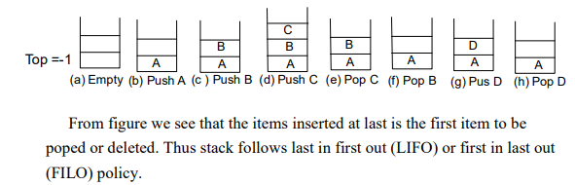

Slide 4
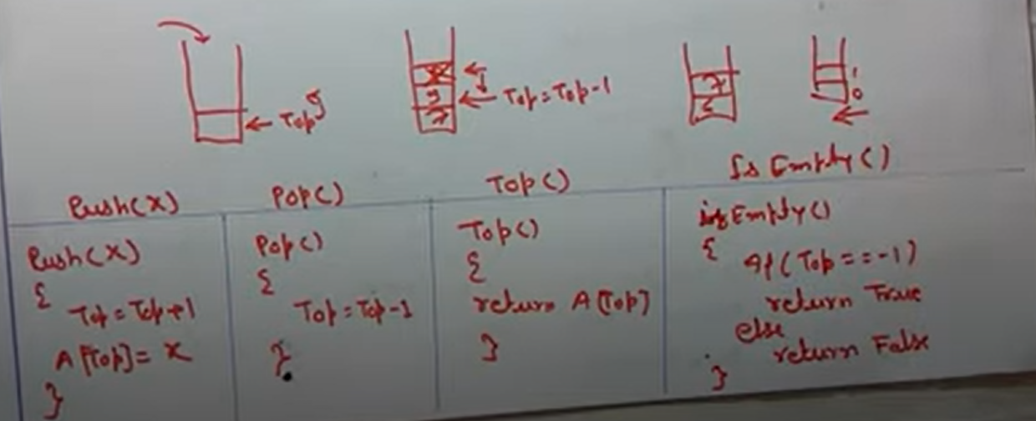
Stack AS an ADT

Slide 5
Operation of Stack:-
Push Operation:-
If (top == (max-1)]
Printf(“stack over flow”);
Else
{
Top == top + 1;
Stack_arr[top] = pushed –item;
}

Slide 6
Pop Operation:-
If (top ==-1)
Printf(“stack underflow”);
Else
{
Printf(“Poped element is %d”,stack_arr[top]);
Top= top – 1;
}

Slide 7
PUSH:- Let stack [Max size] is an array for implementing the stack
1. [check for stack overflow?]
If top = maxsize-1, then print overflow & exit 2. set top = top + 1 (increase top by 1)
3. set stack [top] = item (inserts item in new top position )
4. exit.

Slide 8
POP:-
1. check for the stack underflow
If Top <0 then
Print stack underflow and exit
Else
[Remove the top element]
Set item = stack [ top]
2. Decrement the stack top.
3. Return the deleted item from the stack.
4. Exit.

Slide 9
Application of Stack:-
1 Conversion of an expression from infix to post fix.
2 Evaluation of an arithmetic expression from post fix expression.

Slide 10
Stack Implementation:-.
(i) Array implementation
(ii) Linked list

Slide 11
Array Implementation:-
In Array we can push elements one by one from 0th position 1st position …….. n-1th position.
Any element can be added or deleted at any place and we can push or pop the element from the top of the stack only.
1.When there is no place for adding the element in the array, then this is called stack overflow. So first we check the value of top with size of array.
2. When there is no element in stack, then value of top will be -1. so we check the value of top before deleting the element of stack.

Slide 12
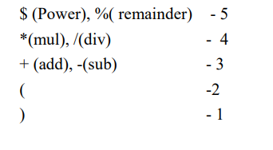
Precedence:-

Slide 13
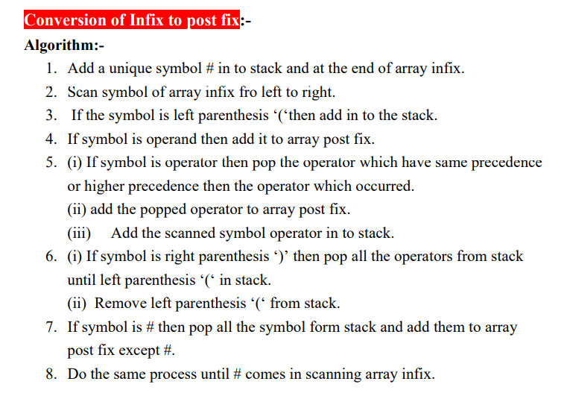

Slide 14
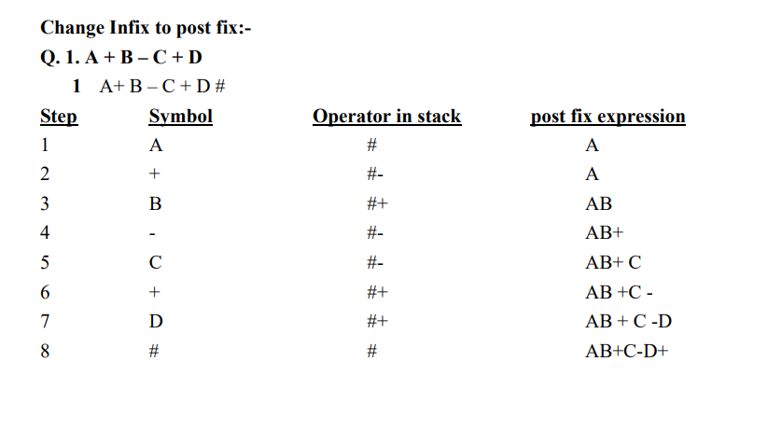

Slide 15
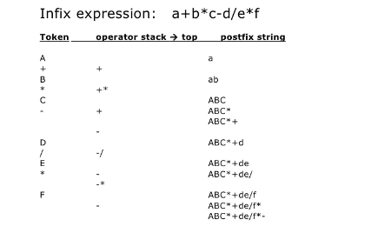

Slide 16
Evaluation of post fix expression:-
In this case stack contents the operands. In stead of operators.
Whenever any operator occurs in scanning we evaluate with last two elements of stack.

Slide 17
Algorithm:-
(i) Add the unique symbol # at the end of array post fix.
(ii) Scan the symbol of array post fix one by one from left to right.
(iii) If symbol is operand, two push in to stack.
(iv) If symbol is operator, then pop last two element of stack and evaluate it as [top- 1] operator [top] & push it to stack.
(v) Do the same process until ‘#’ comes in scanning. (vi) Pop the element of stack which will be value of evaluation of post fix arithmetic expression.

Slide 18
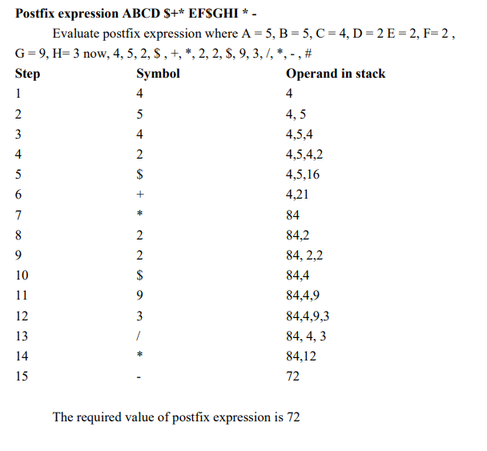

Slide 19
Algorithm to convert Infix To Postfix
Let, X is an arithmetic expression written in infix notation. This algorithm finds the equivalent postfix expression Y.
Push “(“onto Stack, and add “)” to the end of X.
Scan X from left to right and repeat Step 3 to 6 for each element of X until the Stack is empty.
If an operand is encountered, add it to Y.
If a left parenthesis is encountered, push it onto Stack.
If an operator is encountered ,then:
Repeatedly pop from Stack and add to Y each operator (on the top of Stack) which has the same precedence as or higher precedence than operator.
Add operator to Stack. [End of If]
If a right parenthesis is encountered ,then:
Repeatedly pop from Stack and add to Y each operator (on the top of Stack) until a left parenthesis is encountered.
Remove the left Parenthesis. [End of If] [End of If]
END.

Slide 20
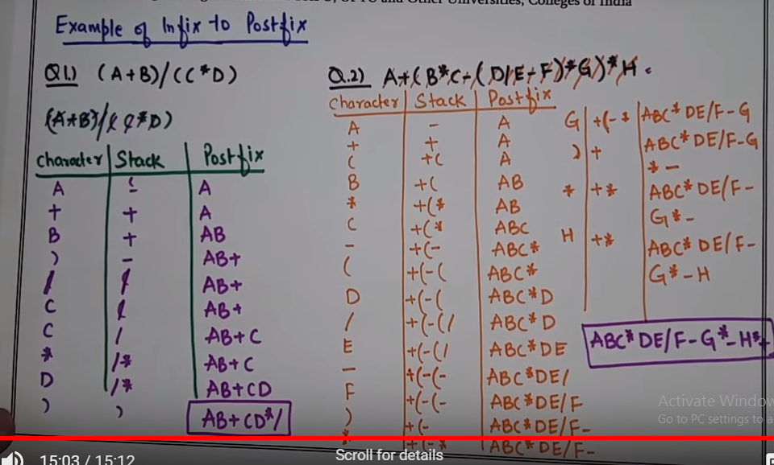

Slide 21
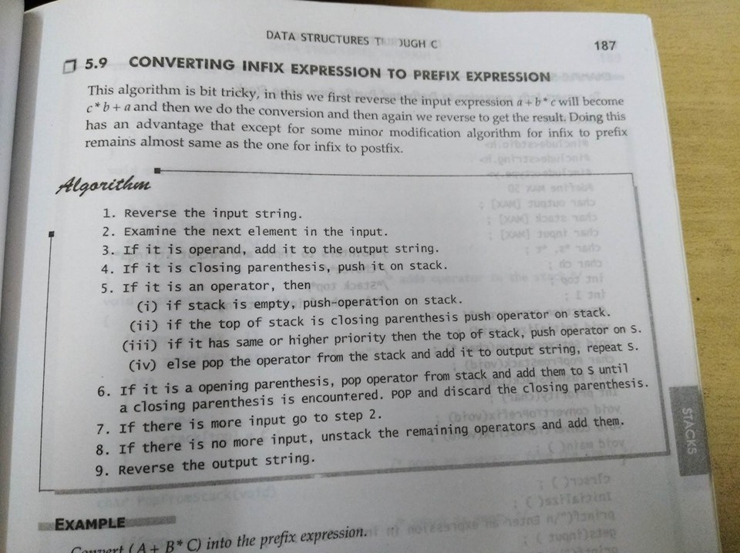

Slide 22
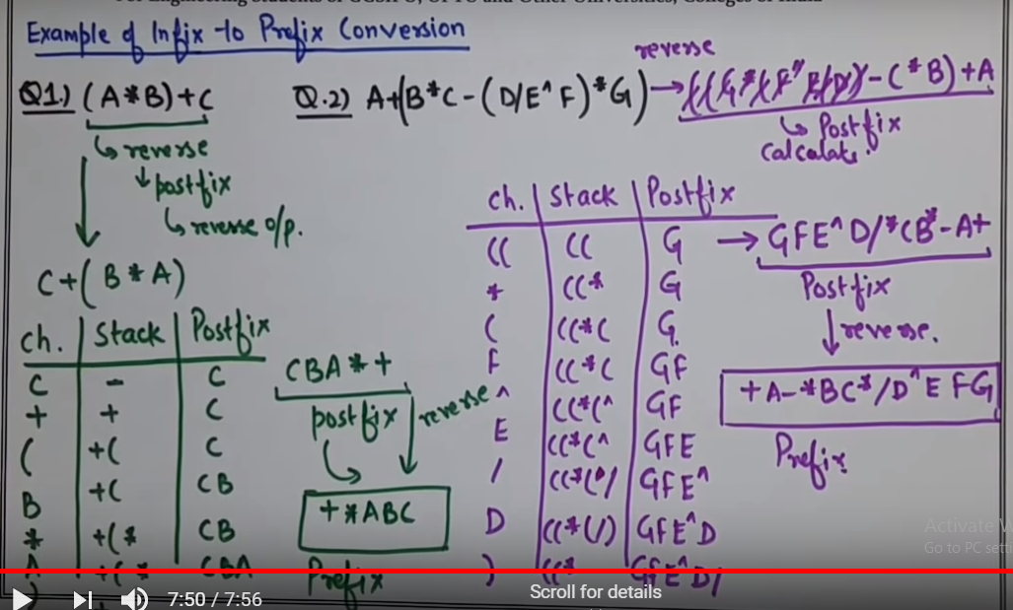

Slide 23
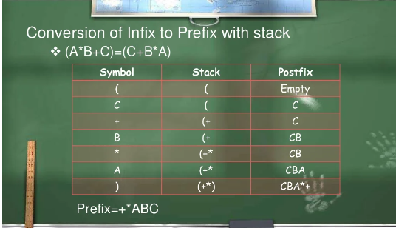

Slide 24
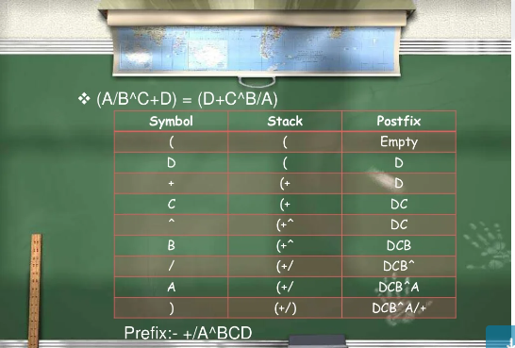

Slide 25
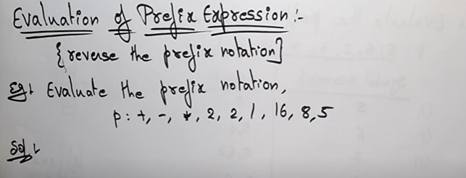

Slide 26
